Slide 1
Characterization of mutational processes affecting metastatic transformation in melanoma and the impact on therapy effectiveness
Doan Trang Laura Vo Ngoc
10 September, 2018
MSc. Genetics of human disease

Slide 2
Metastasis
SEEDING
IMMUNE RECRUITMENT
COLONIZATION
(Lambert, Cell, 2017)
Notes:
Leading cause of death
Seeding into surrounding tissue then bloodstream
Immune recruitment
Invasion and colonization of distant sites
While certain pathways in process are characterized,
mechanism of early metastatic transition is still unclear

Slide 3
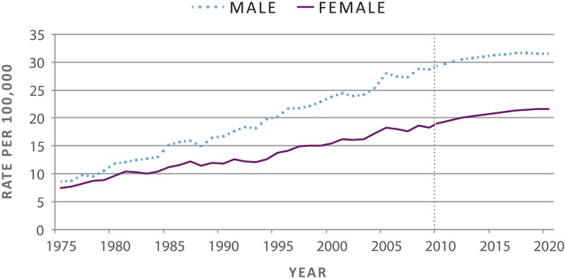
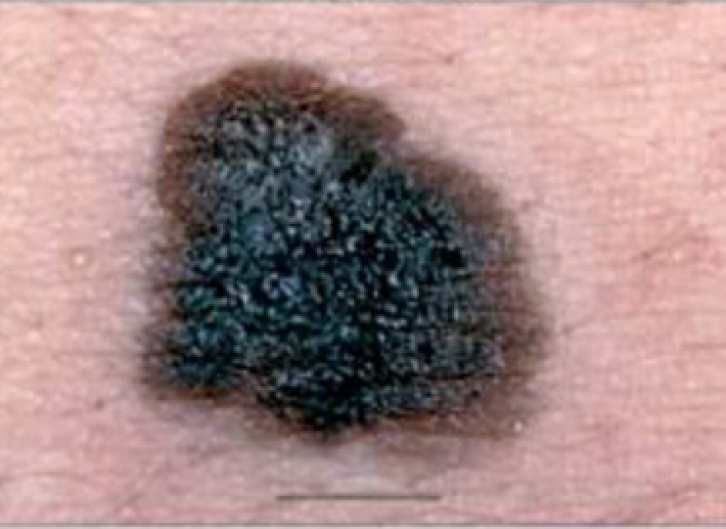
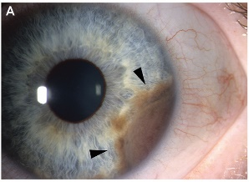
Melanoma
Rising incidence
5-year survival
Primary: 99%
Metastatic: 49%
Subtypes
Acral, mucosal, uveal, cutaneous
Therapies
Surgery
Chemotherapy
Radiotherapy
Targeted therapies
Immune-checkpoint therapies
Cutaneous
Uveal
(US Department of Health and Human Services, 2014 Arrangoiz et al., J. Cancer Treat. Res., 2016)
Notes:
Melanoma – transformation of pigment-producing melanocytes
Subtypes – based on site
Results from mutations in pathways

Slide 4
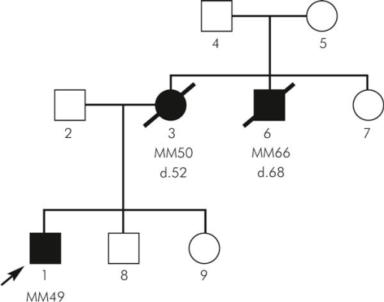

Melanoma risk factors
UV light exposure
Family history
Lighter skin tone
Aging
(Dębniak, Hered. Cancer Clin. Pract., 2004)
Specific mutations
Notes:
Risk factors induce mutations in genome
Mutations are specific and recognizable

Slide 5
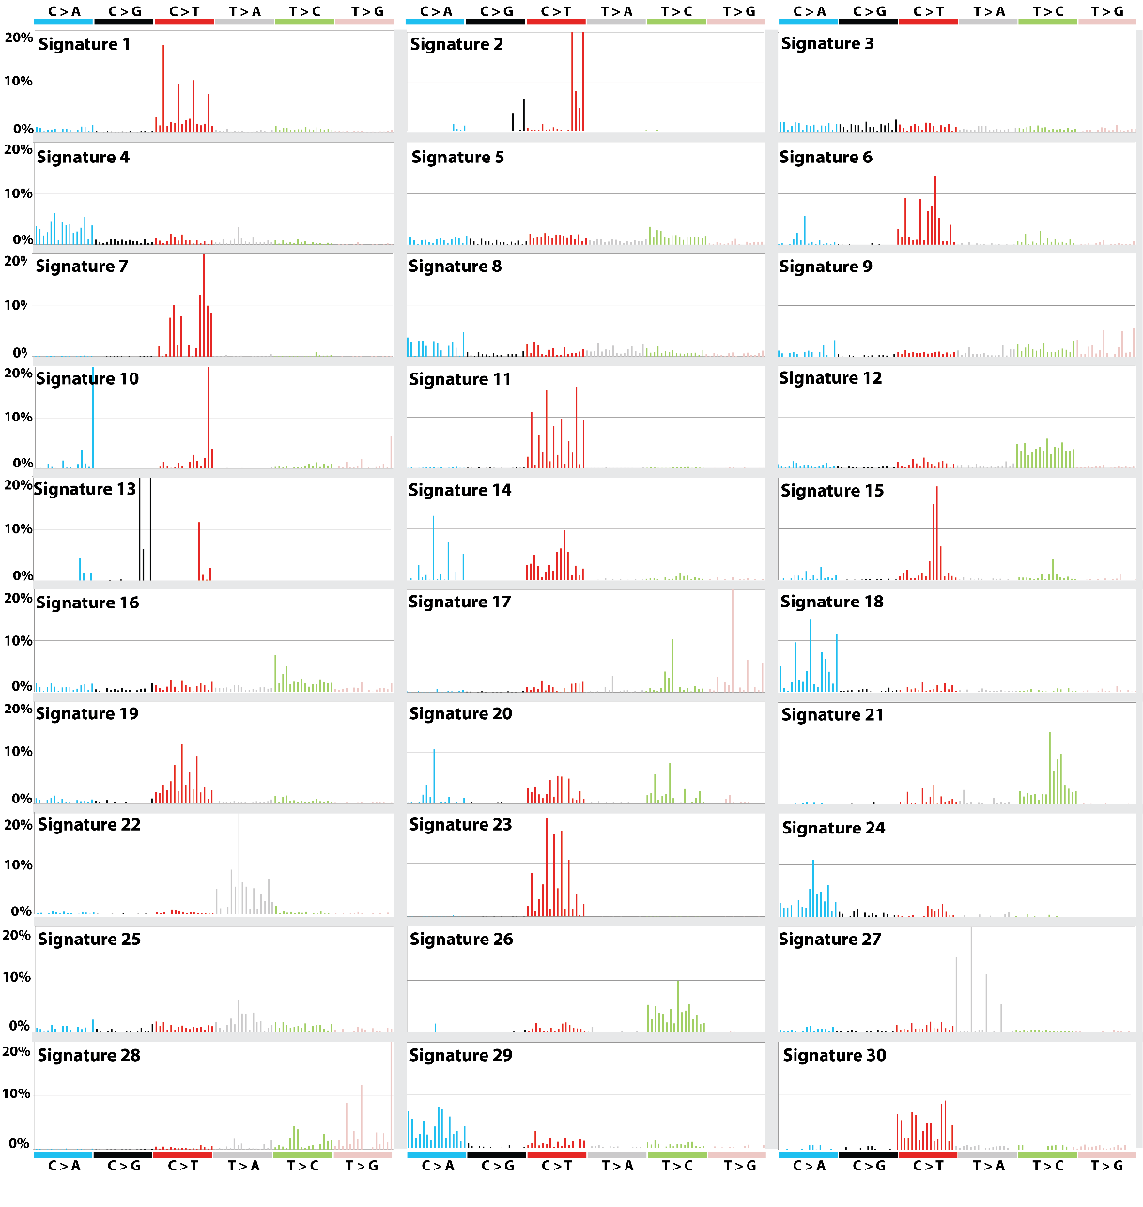

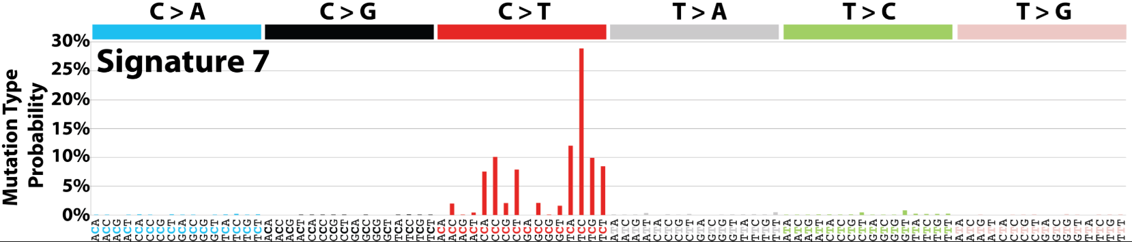
Mutational signatures
Context-specific somatic mutations
Two adjacent bases are important
Example: T[C]C > T[T]C
Associated to risk factors
Identified by non-negative matrix factorization (NMF)
COSMIC https://cancer.sanger.ac.uk/cosmic/signatures
UV LIGHT EXPOSURE
(Alexandrov et al., Nature, 2013; Forbes et al., Nucleic Acid Res.,2018)
Notes:
Sigs – specific patterns of mutations in genome
– 30 validated signatures
– each associated to risk factors
NMF – identified using NMF or similar methods
– identifies patterns in genomes and how prevalent they are

Slide 6
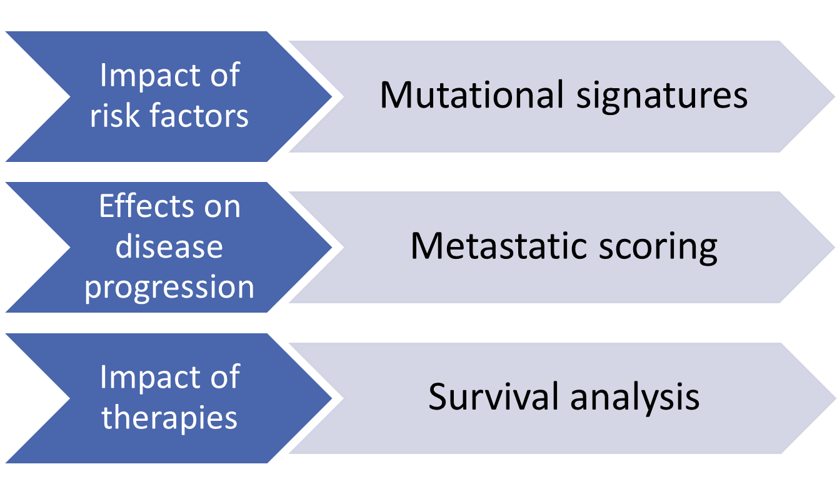
Aims & methods overview

Slide 7



Methods
The Cancer Genome Atlas (TCGA)
Whole exome sequencing
Clinical data
Gene expression data
Two cohorts
Skin cutaneous melanoma (n=487)
Uveal melanoma (n=80)
Validation dataset – International Cancer Genome Consortium (ICGC)
Whole genome sequencing
Two cohorts
Australian melanoma (n=107)
Brazilian skin adenocarcinoma (n=100)

Slide 8
Methods
The Cancer Genome Atlas (TCGA)
Whole exome sequencing
Clinical data
Gene expression data
Two cohorts
Skin cutaneous melanoma (SKCM)
Uveal melanoma (UVM)
Validation dataset – International Cancer Genome Consortium (ICGC)
Whole genome sequencing
Two cohorts
Australian melanoma (n=107)
Brazilian skin adenocarcinoma (n=100)

Slide 9
Results

Slide 10
Mutational signatures
primary
metastatic
Notes:
Inferred mutsigs
Different landscapes

Slide 11
Top 5 contributors
Sample | Signatures | Etiology
SKCM | S7 | UV light exposure
 | S1 | Aging
 | S11 | Alkylating agents
 | S23 | Unknown; strong transcriptional strand bias
 | S6 | Defective DNA mismatch repair
UVM | S1 | Aging
 | S22 | Aristolochic acid
 | S15 | Defective DNA mismatch repair
 | S3 | DNA double-strand break repair failure
 | S6 | Defective DNA mismatch repair
Notes:
Including a number of signatures associated with defective repair pathways
Next, want to see impact on metastatic progression

Slide 12
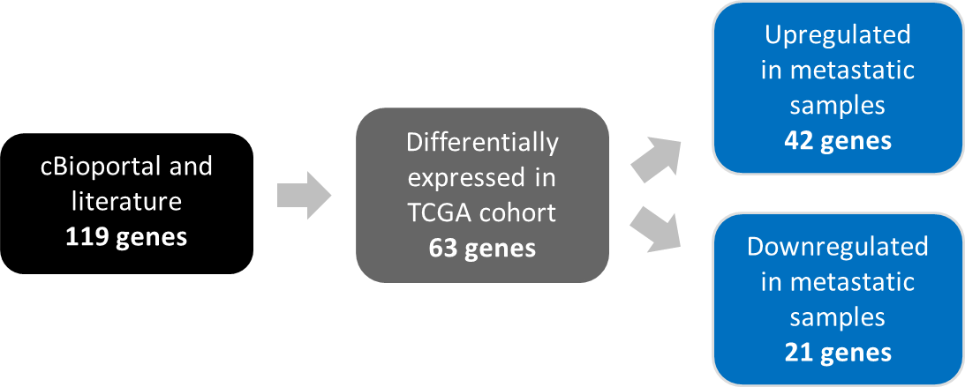
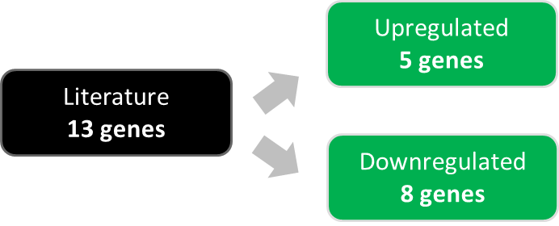
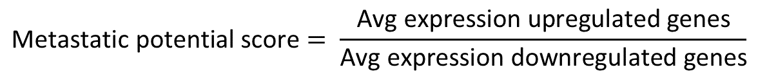
Metastatic scoring in primary tumors
CDK1, DNA2, HMGA2,
certain MMPs
…
SKCM
CDH1, CDK2, GALK1,
certain MMPs
…
CDH1, ECM1, HTR2B, PRAME, RAB31
UVM
EIF1B, FXR1, ID2, LMCD1, LTA4H
…
$$\text{Metastatic} \text{potential} \text{score}= \frac{\text{Avg} \text{expression} \text{upregulated} \text{genes}}{\text{Avg} \text{expression} \text{downregulated} \text{genes}}$$
Notes:
Score of metastatic potential in primary tumors
Based on expression of metastatic marker genes
Genes selected using different approaches based on data availability:
– UVM has no metastatic samples
Upreg and downreg

Slide 13
Metastatic score correlates (primary SKCM)
Signature 1 (aging)
Correlation coefficient = 0.16
p = 0.10
Signature prevalence alone
Signature 7 (UV)
Correlation coefficient = 0.14
p = 0.17
Notes:
Now that defined metscore, can see whether any mutsig associate with metpot
See that when looked at blindly don’t see anything, but when look at gen context we do see
Be warned that the next slide has images of a melanoma patient which may be disturbing

Slide 14
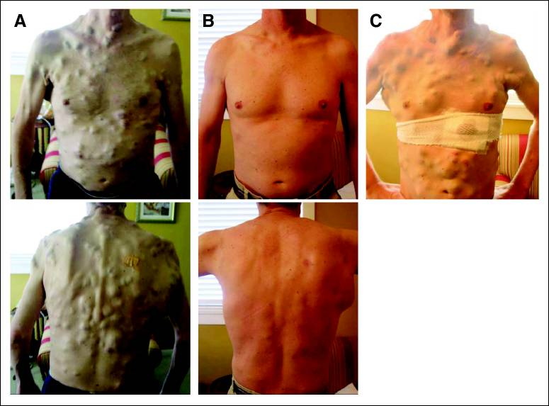
BRAF: driver of melanoma
Before treatment | 15 weeks of therapy | 23 weeks of therapy
BRAF mutated in 40-60% patients
Inhibitors used for targeted therapies
Eventual resistance
(Wagle et al., J. Clin. Onco., 2011)
Notes:
See whether genetic context impacts correlation, look at BRAF
BRAF is gene mutated in 40-60% patients
Targeted with inhibitors as a treatment, effective initially but unfortunately lead to resistance and relapse in patient

Slide 15
Metastatic score correlates (primary SKCM)
Signature 1 (aging)
Correlation coefficient = 0.43
p = 0.03
Signature prevalence alone
Signature prevalence in genetic context (BRAF WT)
Signature 7 (UV)
Correlation coefficient = 0.46
p = 0.02
Notes:
In BRAF WT, significant correlation between sig contribution and metscore

Slide 16
Metastatic score correlates (primary SKCM)
Signature 1 (aging)
Correlation coefficient = 0.04
p = 0.82
Signature prevalence alone
Signature prevalence in genetic context (BRAF WT)
Signature prevalence in genetic context (BRAF mutant)
Signature 7 (UV)
Correlation coefficient = 0.11
p = 0.57
Notes:
But not in patients with BRAF mutation
Indicate that in absence of mutation, risk factor drive progression

Slide 17
Survival
Primary SKCM
Therapies
Risk factors (mutational signatures)
Notes:
Moving on to survival:
Look at therapies and clinical factors impacting survival in patients
Such as cancer stage, with advanced stage presenting worse survival as see
Why we look at survival and sigs
- Risk factors may sensitize cells to therapies differently and thus impact outcome
- Signature -> earlier metast -> diff response to treatment -> survival

Slide 18
Multivariate survival models
↑ risk of death
↓ risk of death
Not statistically significant
Primary SKCM (n=27)
Brazilian cohort (n=95)
Metastatic SKCM (n=21)
Risk of death
Australian cohort (n=94)
Notes:
Shows impact of each of these parameter on risk of death
Signatures and stage impact survival in primary SKCM
Different signatures impact survival when accounting for therapies
Similar signature impacting in Brazilian
Different factors impacting in Australian

Slide 19
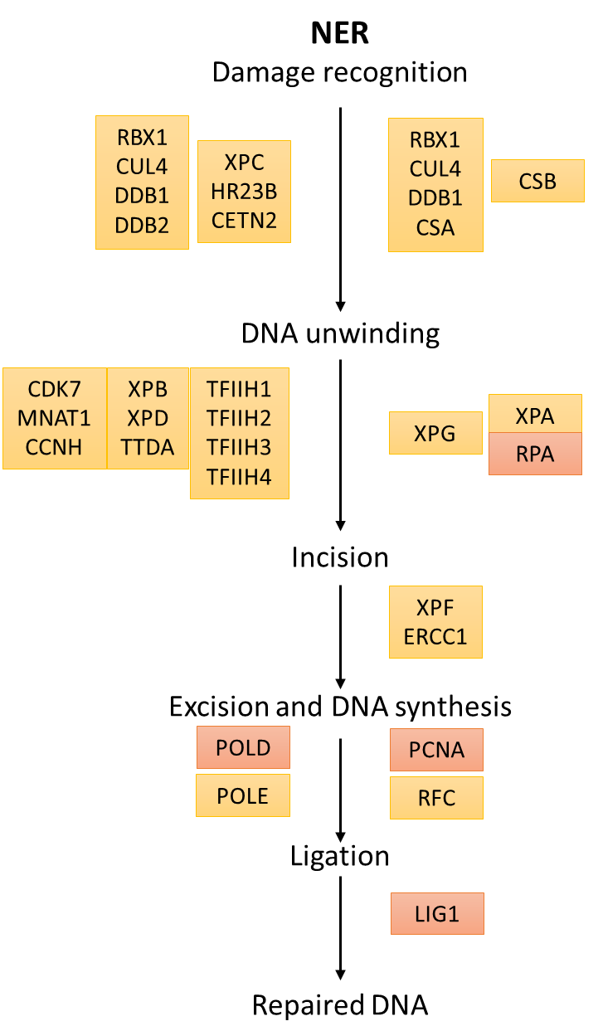
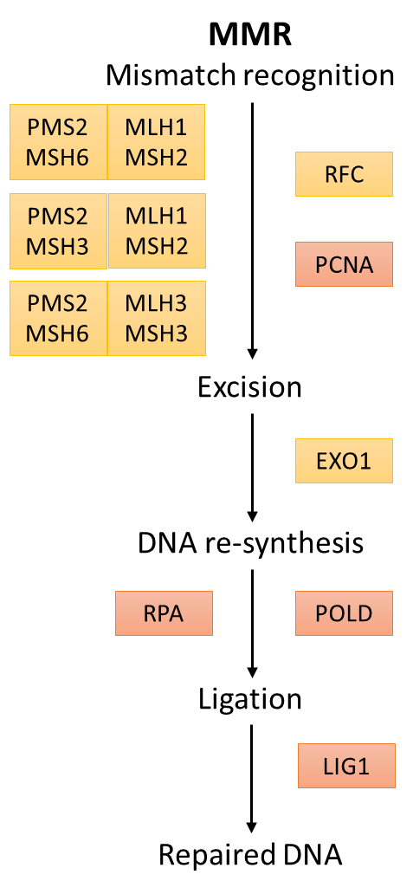
NER / MMR
Nucleotide excision repair (NER) | Mismatch repair (MMR) | Others with transcriptional strand bias
S4 | S6 | S2
S7 | S15 | S5
S11 | S20 | S12
S22 | S26 | S23
S24 |  | S27
S25
Genes in NER/MMR pathways (POLD, LIG1, RFC, …) correlate with metastatic potential
Notes:
As signatures impacting survival are involved in repair
Correlated expression of these genes with metastatic potential score
Further argument for involvement of ner/mmr pathways in metast progression

Slide 20
Survival model in combined cohort
↑ risk of death
↓ risk of death
Not statistically significant
Risk of death
Notes:
NER –associated sigs no longer impact
S6 (MMR) again impacts in context of improved survival due to ther

Slide 21
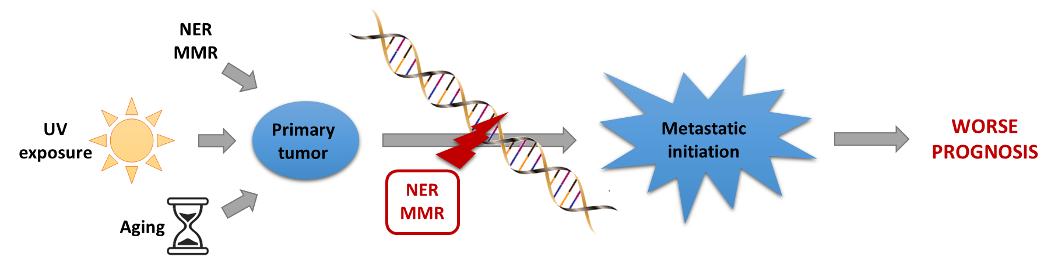
Conclusion
UV light + BRAF WT
Repair pathways, and UV exposure in absence of BRAF mutation, drive metastatic progression and worse prognosis in the context of radiotherapy and surgery.
Notes:
Risk factors result in mutations leading to disease presentation
But repair pathways and UV exposure in absence of BRAF mutation drive metastatic progression
Leading to worse prognosis

Slide 22
Some limitations
TCGA limitations
Small sample size
Non-uniform and missing clinical annotations
Lack of samples from same patient
Whole exome sequencing
ICGC lack of expression data
TCGA and ICGC data differences (WES vs. WGS)
Notes:
Range of limitations listed here
Don’t have time to go through all
Highlight:
lack of clinical annotations (especially survival)
differences between discovery and valid cohorts data

Slide 23
Future research
Replication in larger cohorts
Better clinical data annotation
Uniformalized data acquisition methods
More complete survival annotation
Metastatic scoring
More specific marker genes
Chromosomal instability
Comparison with new mutational signatures (Alexandrov et al., 2018)
Comparison with cancer in other tissues
(Alexandrov et al., Nature, 2013)
(Alexandrov et al., bioRxiv, 2018)
Notes:
Larger, better annotated cohorts but no more details
Better methods for metastatic scoring and validation
New mutsigs characterized recently

Slide 24


Acknowledgements
Dr. Maria Secrier
Prof. Nik
Maniatis
Project supervisor
Personal tutor
Coding/debugging help
GHD teaching & admin staff
Family
& friends
Endless support
Thank you for listening!
ANY QUESTIONS?
Notes:
Clinical application
Basis for a prognostic framework for patients (predicting outcome)
Sequencing primary tumor for signatures
Use contributions of NER/MMR sigs (and UV in BRAF WT)
Limitations:
Sequencing costs -- worth it? I think yes
Threshold of contribution for high/low risk of death to be defined
Experimental validation
Animal models (mouse)
Melanoma model: KO tumor suppressors (p53,…), activate oncogenes (BRAF)
Induce NER/MMR damage (KO important genes)
See if changes in metastatic progression
Then add therapies (surgery, radiotherapy) and observe
Find more specific sigs association to pathways
Limitations
Require many samples
Each sample will react differently to treatment
Signatures may be different in animals
Metastatic cell line
Evidence of mutational signatures involved
Can compare to primary cell line but not ideal
Any validation will have to focus on one question at a time
More computational analyses to perform before experimental validation

Slide 25
References
Alexandrov LB, Nik-Zainal S, Wedge DC, et al. Signatures of mutational processes in human cancer. Nature. 2013;500(7463):415-421.
Arrangoiz R. Melanoma Review: Epidemiology, Risk Factors, Diagnosis and Staging. J Cancer Treat Res. 2016;4(1):1.
Dębniak, T., 2004. Familial Malignant Melanoma - Overview. Hered. Cancer Clin. Pract. 2, 123. https://doi.org/10.1186/1897-4287-2-3-123
Forbes, S.A., Bindal, N., Bamford, S., Cole, C., Kok, C.Y., Beare, D., Jia, M., Shepherd, R., Leung, K., Menzies, A., Teague, J.W., Campbell, P.J., Stratton, M.R., Futreal, P.A., 2011. COSMIC: mining complete cancer genomes in the Catalogue of Somatic Mutations in Cancer. Nucleic Acids Res. 39, D945–D950. https://doi.org/10.1093/nar/gkq929
Lambert AW, Pattabiraman DR, Weinberg RA. Emerging Biological Principles of Metastasis. Cell. 2017;168(4):670-691.
Lo, J.A., Fisher, D.E., 2014. The melanoma revolution: From UV carcinogenesis to a new era in therapeutics. Science (80-. ). 346, 945–949. https://doi.org/10.1126/science.1253735
Sandru A, Voinea S, Panaitescu E, Blidaru A. Survival rates of patients with metastatic malignant melanoma. J Med Life. 2014;7(4):572-576.
US Department of Health and Human Services, 2014. Figure 3, Age-Adjusted Melanoma Incidence Rates, Actual and Projected, by Sex, 1975–2020, in: The Surgeon General’s Call to Action to Prevent Skin Cancer. Office of the Surgeon General (US), Washington (DC).
US National Institutes of Health National Cancer Institute, 2018. SEER Training Modules, Nerve Tissue [WWW Document]. URL https://training.seer.cancer.gov/anatomy/nervous/tissue.html (accessed 02.09.18).
Wagle, N., Emery, C., Berger, M.F., Davis, M.J., Sawyer, A., Pochanard, P., Kehoe, S.M., Johannessen, C.M., MacConaill, L.E., Hahn, W.C., Meyerson, M., Garraway, L.A., 2011. Dissecting Therapeutic Resistance to RAF Inhibition in Melanoma by Tumor Genomic Profiling. J. Clin. Oncol. 29, 3085–3096. https://doi.org/10.1200/JCO.2010.33.2312

Slide 26
Appendix

Slide 27
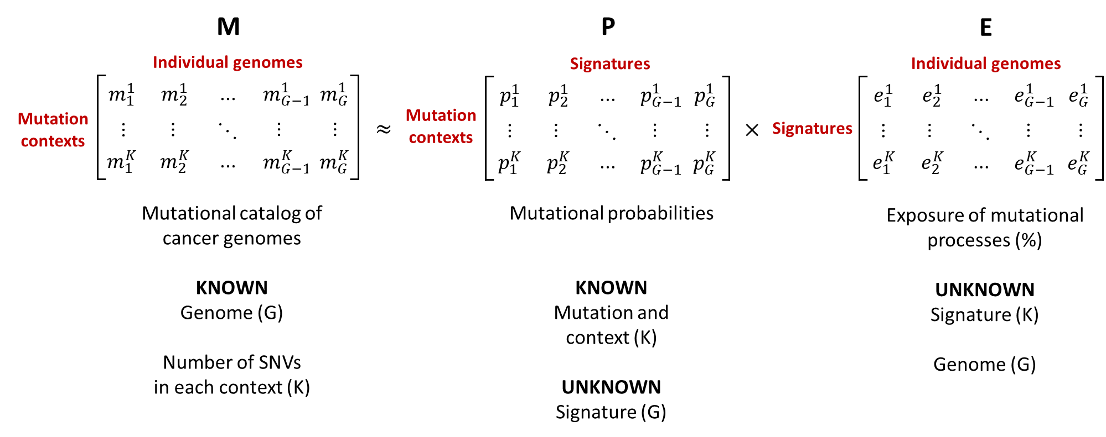
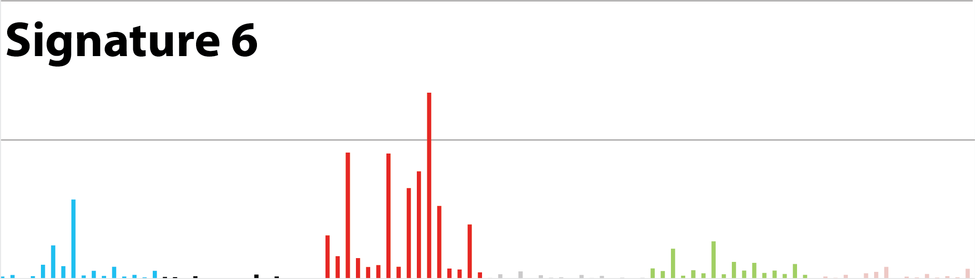
Non-negative matrix factorization (NMF)
Notes:
NMF:
Method based on matrix multiplication
Need total number of mutation of each type
Want to identify patterns of muts in each context and number of patterns that can be identified in genome
Similar to principle-component analysis (PCA)
PCA: segregate into clusters
NMF: segragate into clusters associated with risk factors
Non-negative
Hard to solve
Estimate matrix M (how close to genome)
Differences from M = error --> minimize

Slide 28
Primary SKCM | Metastatic SKCM | Primary UVM
METASTATIC SCORING
Notes:
Cancer stage – numbered system to indicate disease progression (1 to 4)
– higher cancer stage indicates more advanced disease
Expect risk of metatast to increase with advanced stage
Metscore increases with stage in primary
Decreases in metastatic, likely due to less risk of metastasis following a metastatic event

Slide 29
ICGC mutational signatures
Brazilian cohort
Australian cohort

Slide 30
SKCM upregulated metastatic marker genes

Slide 31
SKCM downregulated metastatic marker genes

Slide 32
UVM metastatic marker genes

